Slide 1
MOOCs, Past, Present, and Future
Dr. Charles Severance
www.dr-chuck.com

Slide 2
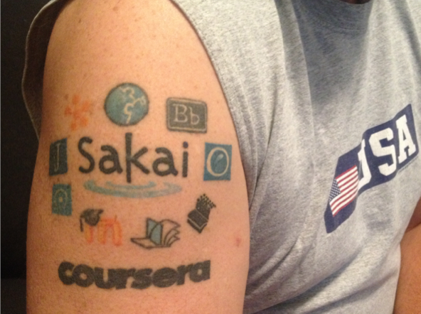
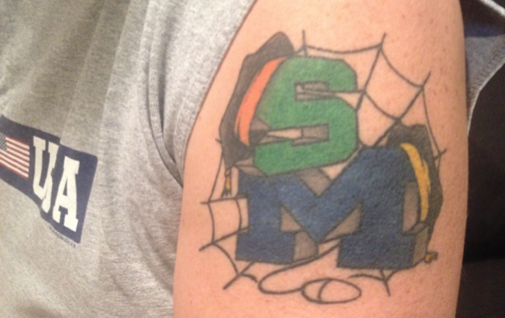
About Me

Slide 3
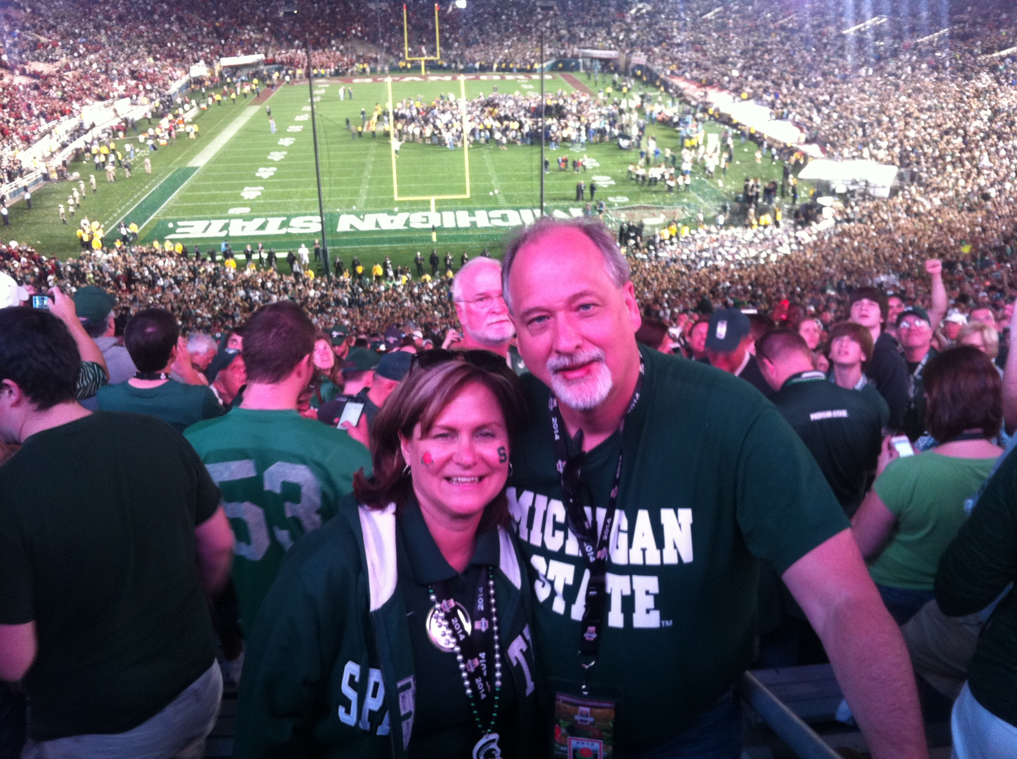
2014

Slide 4
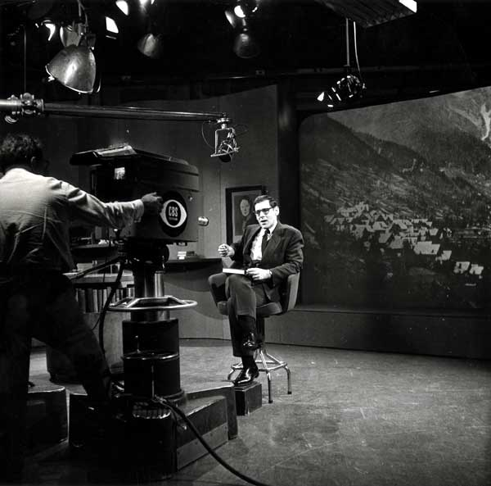
Sunrise Semester
New York University
CBS – 6:00AM
1957-1982
120K students
Precursor to PBS
https://en.wikipedia.org/wiki/Sunrise_Semester

Slide 5

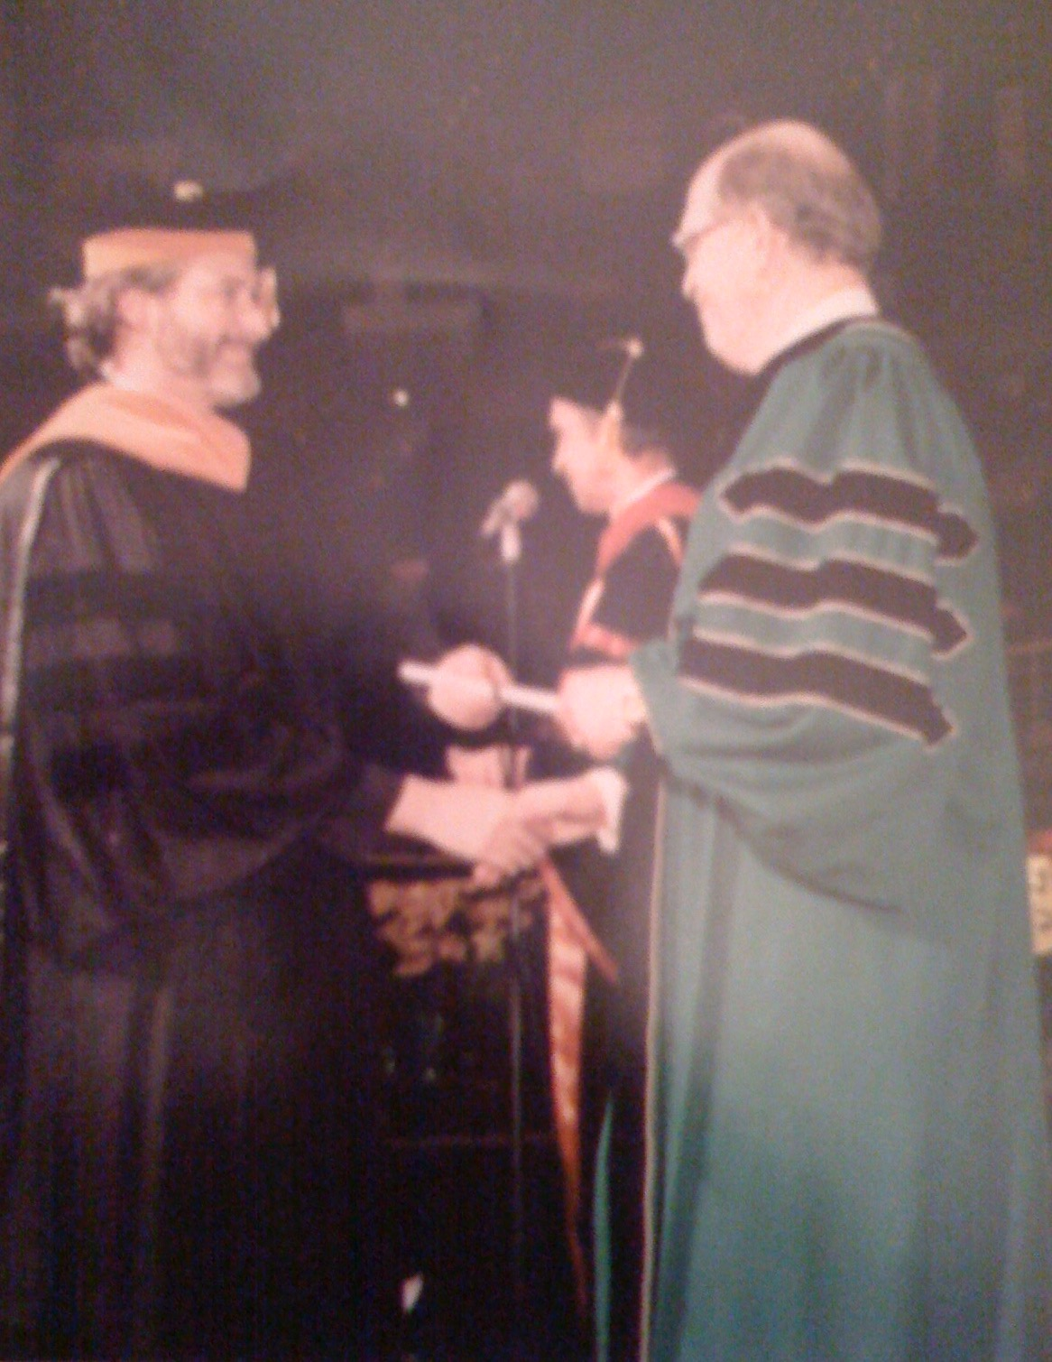
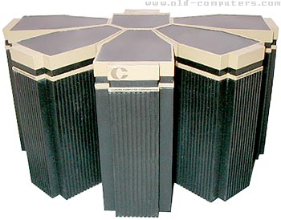
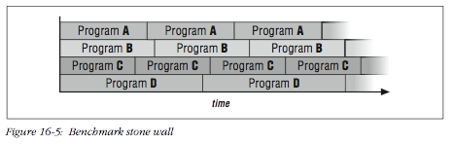
1996

Slide 6
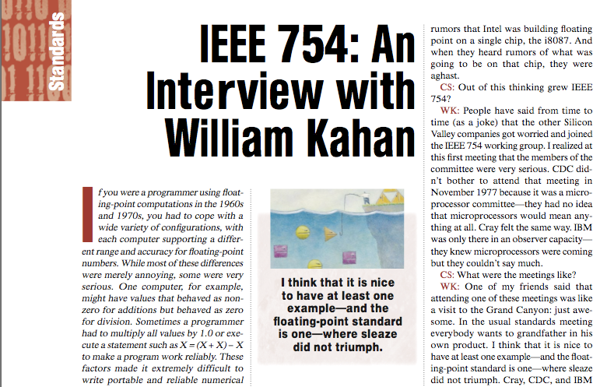
1996

Slide 7
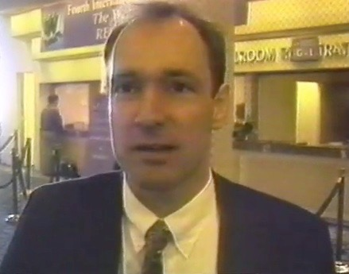
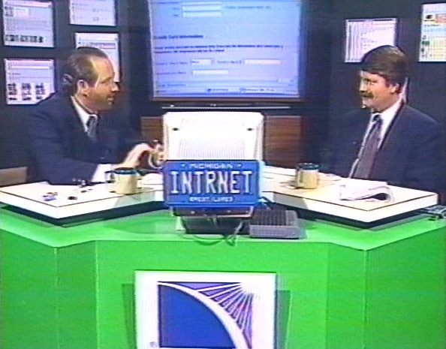
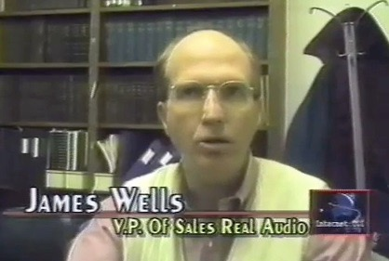
1996

Slide 8
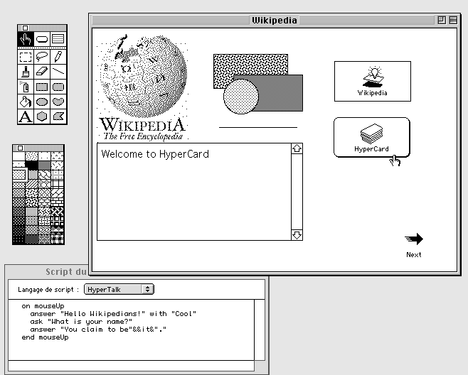
1996

Slide 9
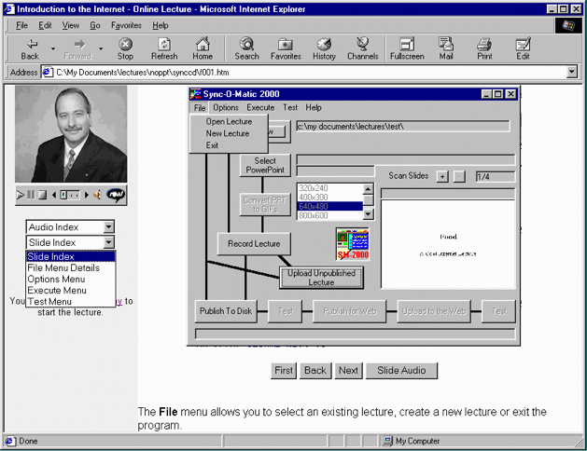
1996

Slide 10
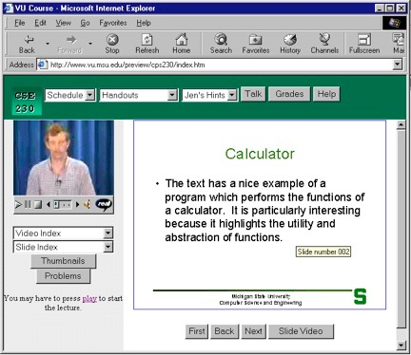
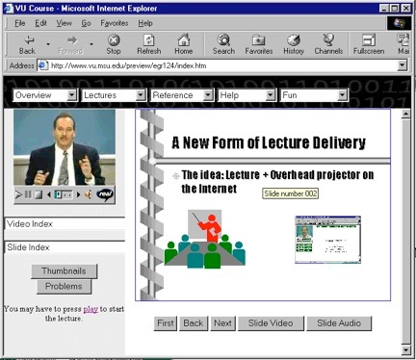
Sync-O-Matic
www.syncomat.com
1997

Slide 11
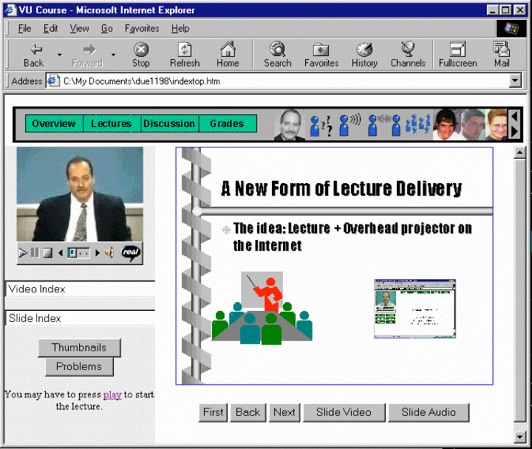
Title: Using Asynchronous, Web-based, Video to Humanize Distance Education
1998

Slide 12
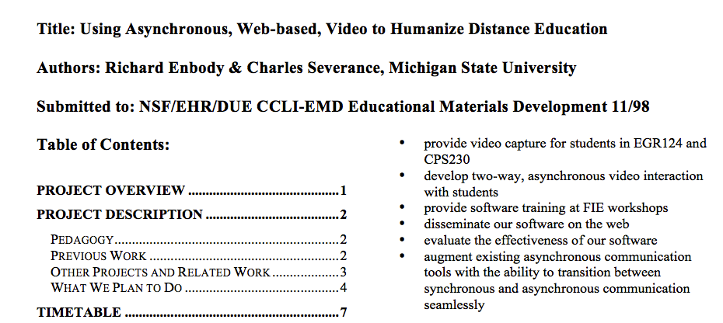
1998
http://www-personal.umich.edu/~csev/papers/1998/due1198e.pdf

Slide 13
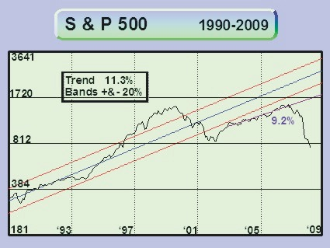
You are Here
1998

Slide 14

1999

Slide 15
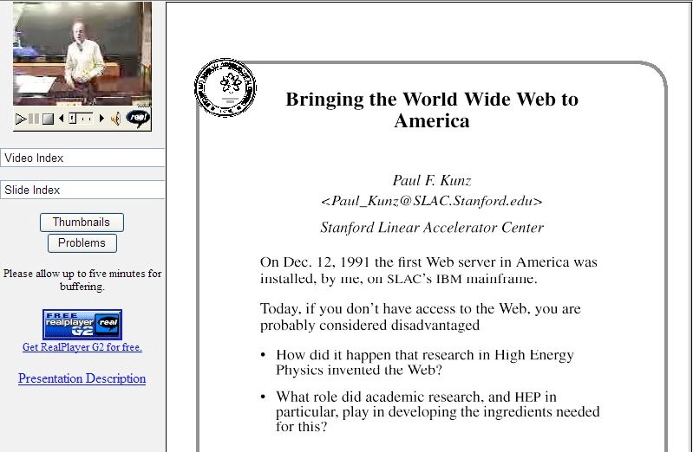
1999

Slide 16
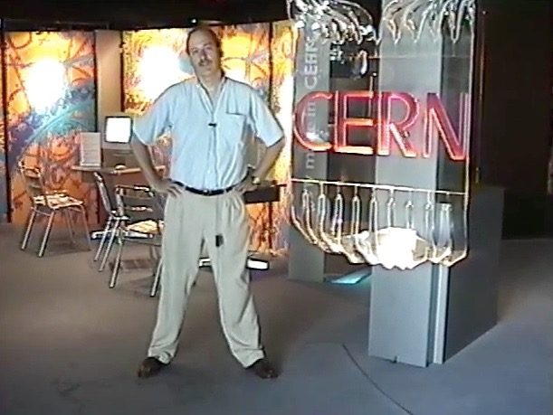
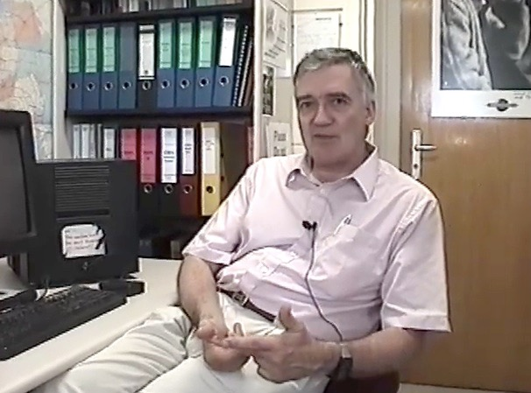
Robert Cailliau
co-Inventor of the
World-Wide Web
1999

Slide 17
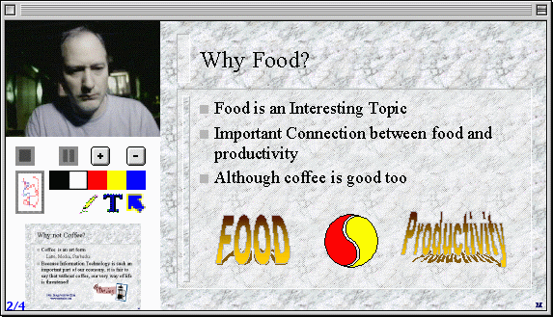
2000
http://www-personal.umich.edu/~csev/csev/projects/cb2k/index.htm

Slide 18

Microsoft Exchange + Learning Modules =
Microsoft Learning Network (MLN)
2001

Slide 19
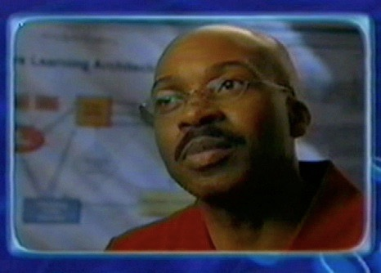
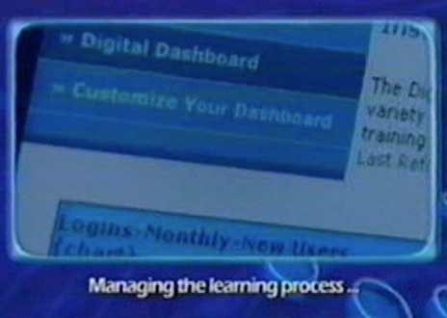
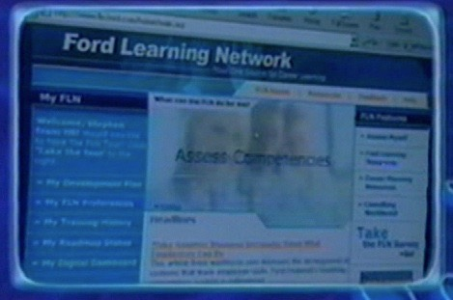

Ford Learning Network
2002
http://www.autonomy.com/content/Customers/ShowReel/case-studies/Ford.en.html

Slide 20

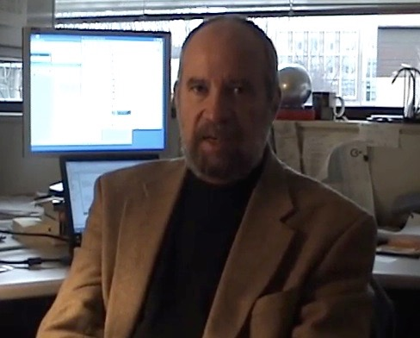
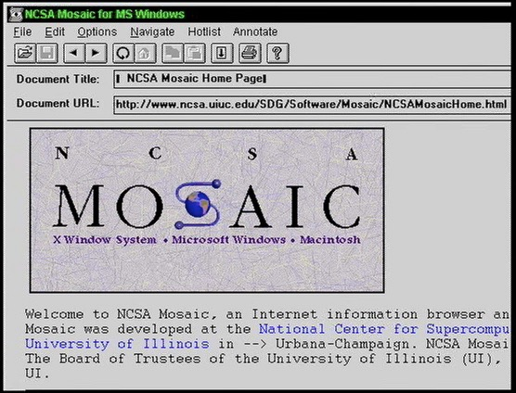
2003

Slide 21
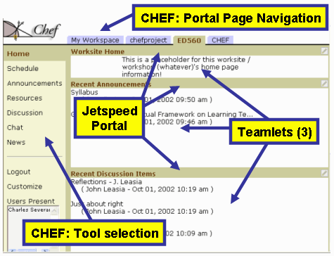
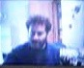
2003

Slide 22
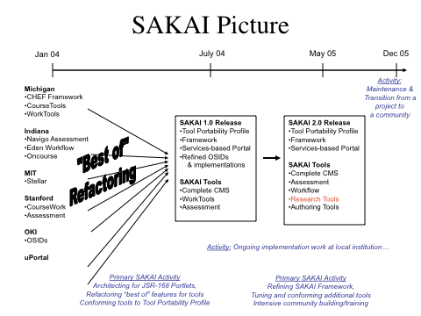
2003

Slide 23

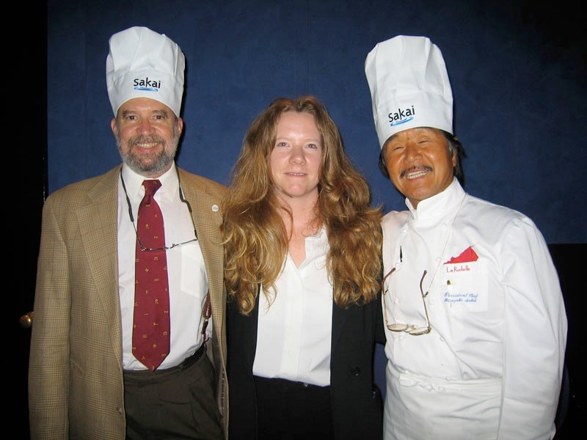
2004

Slide 24




Learning Tools Interoperability
2004

Slide 25
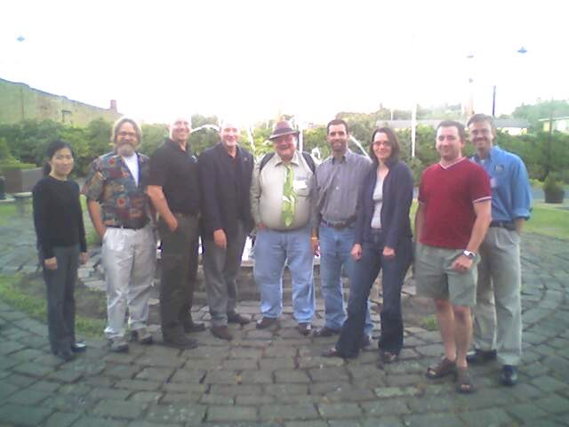
IMS Tools Interoperability
Demonstrator
Sheffield, UK
2005

Slide 26
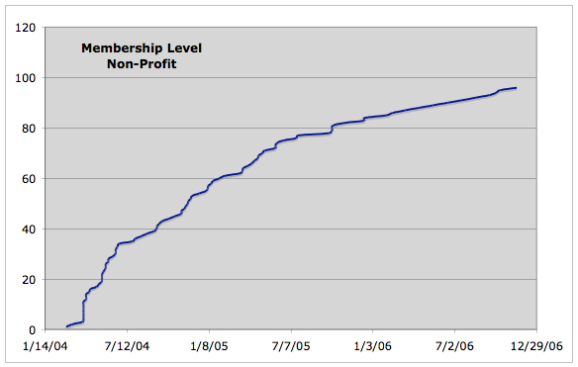
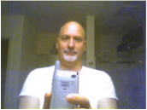

Slide 27
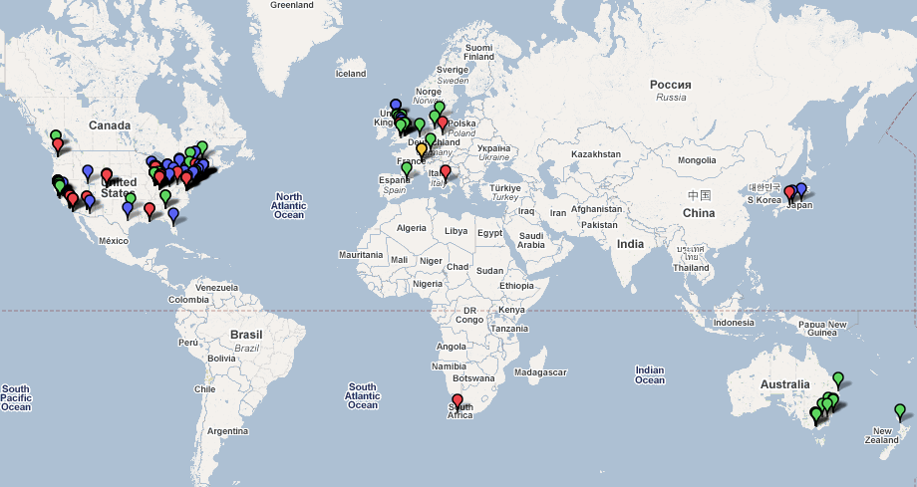
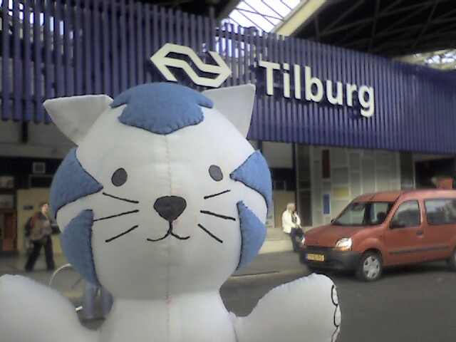

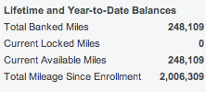
Dr. Chuck Travel 2004-2006

Slide 28
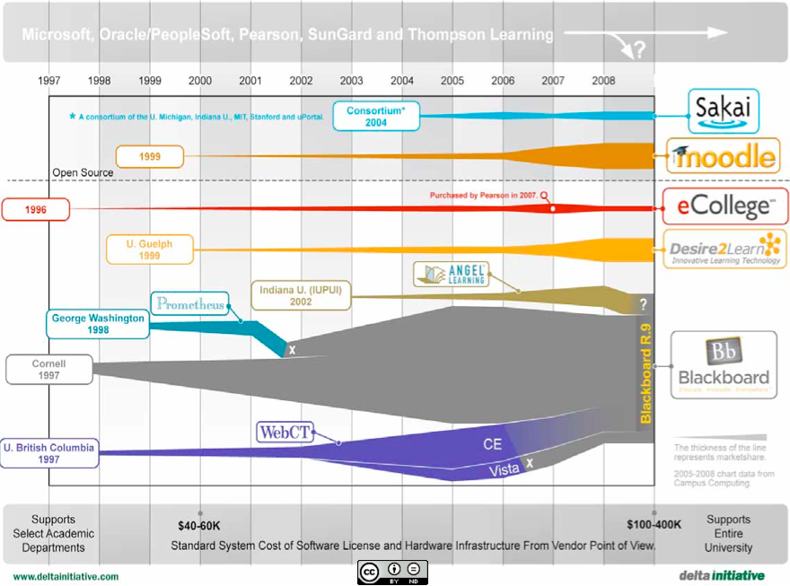

Slide 29
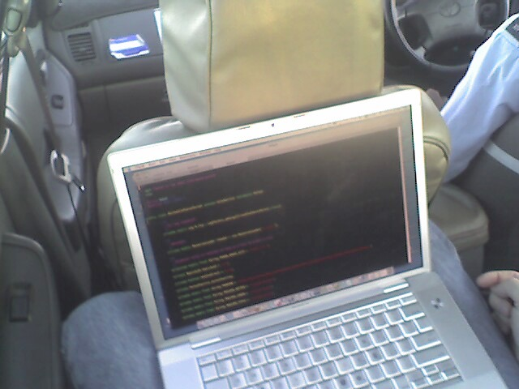
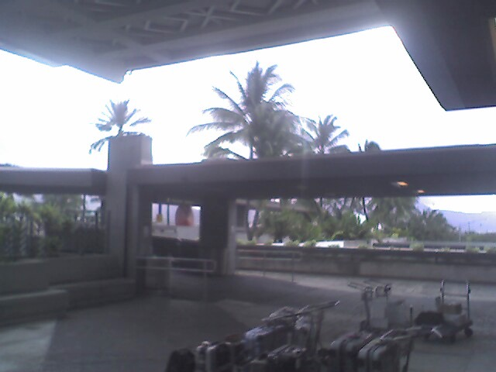
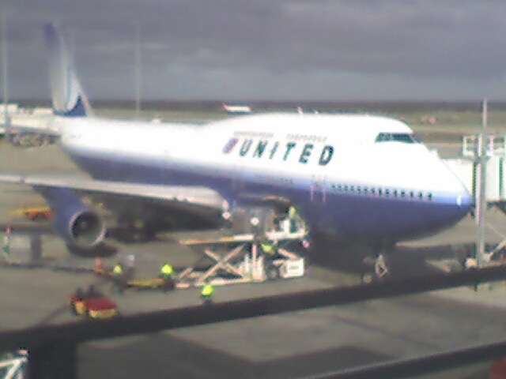
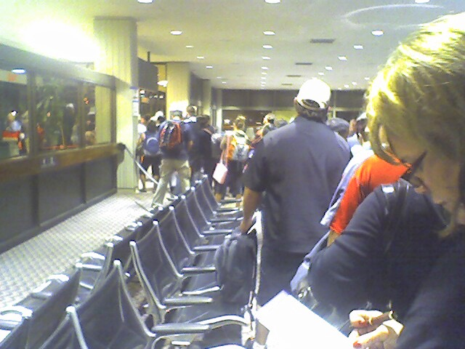
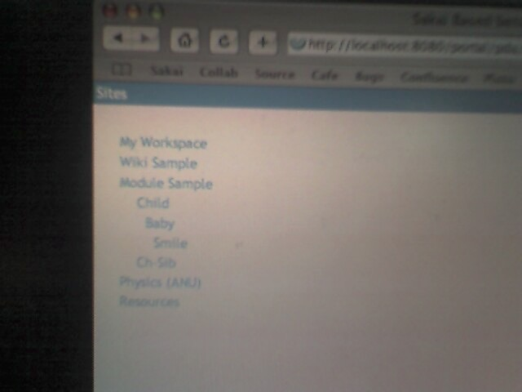
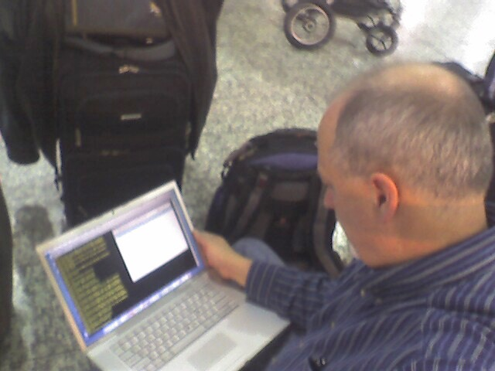
2006

Slide 30
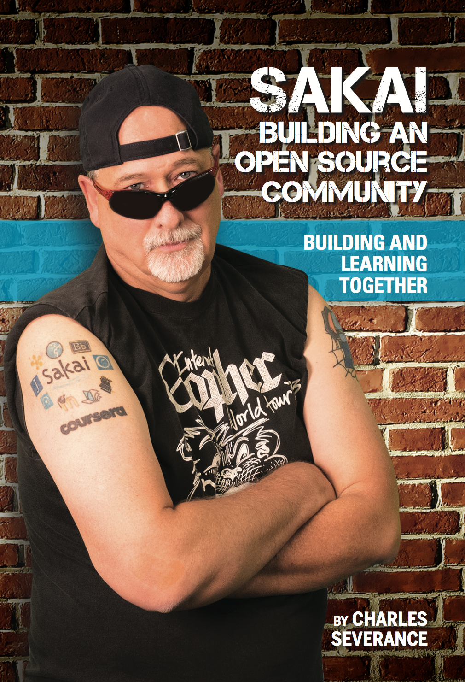

Slide 31
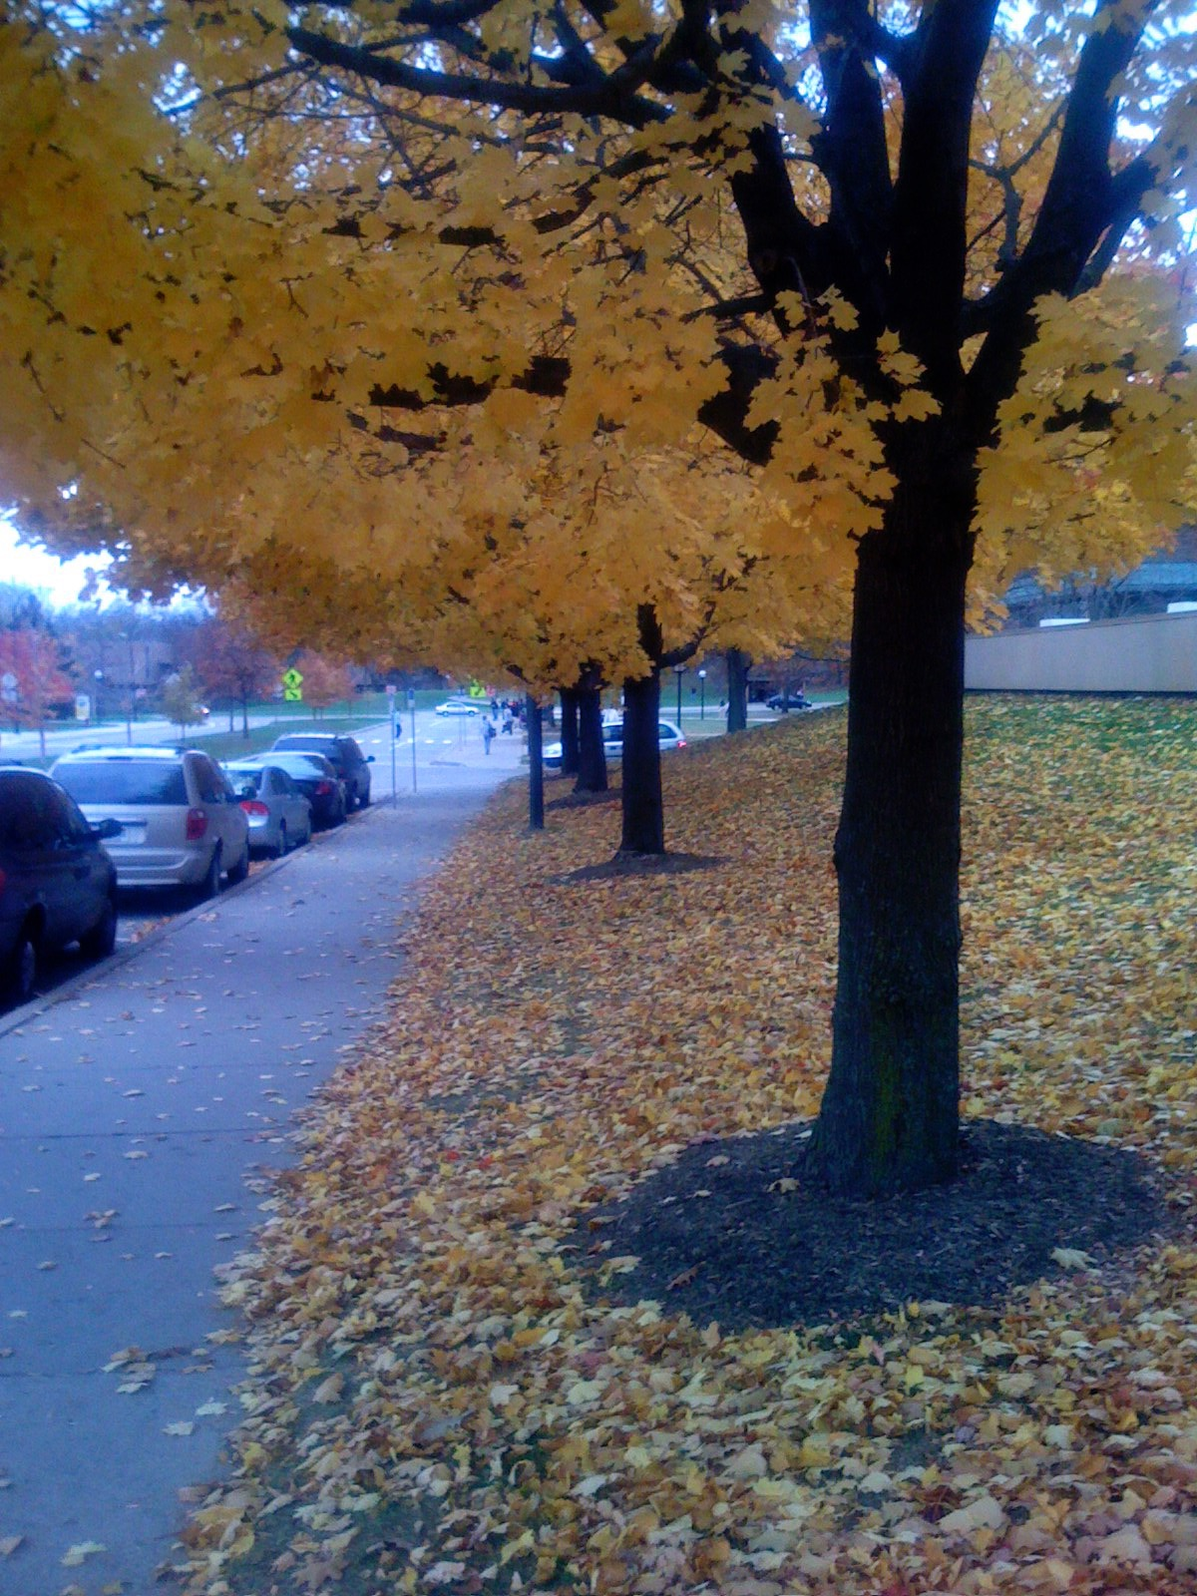
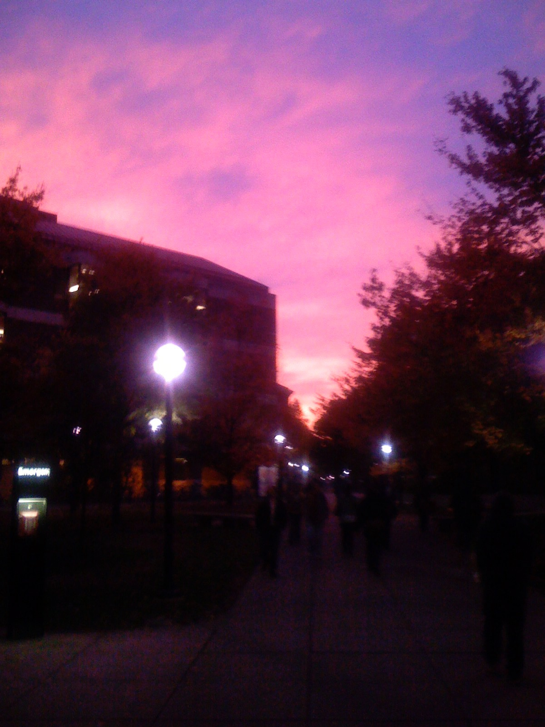
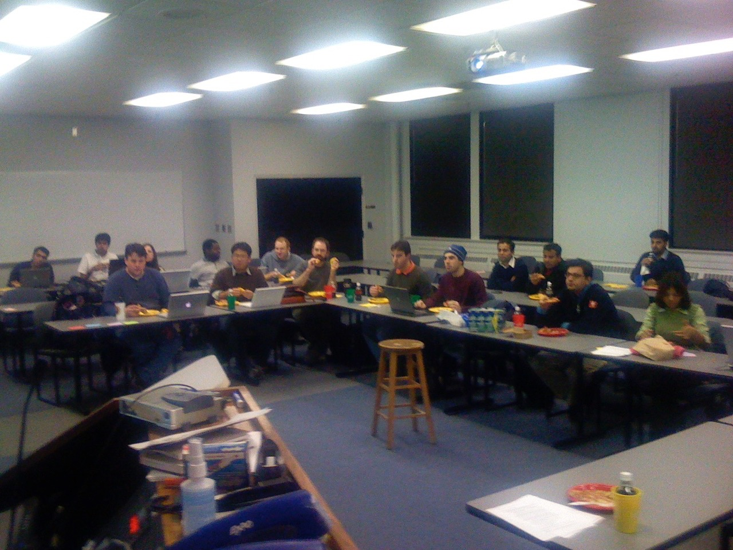
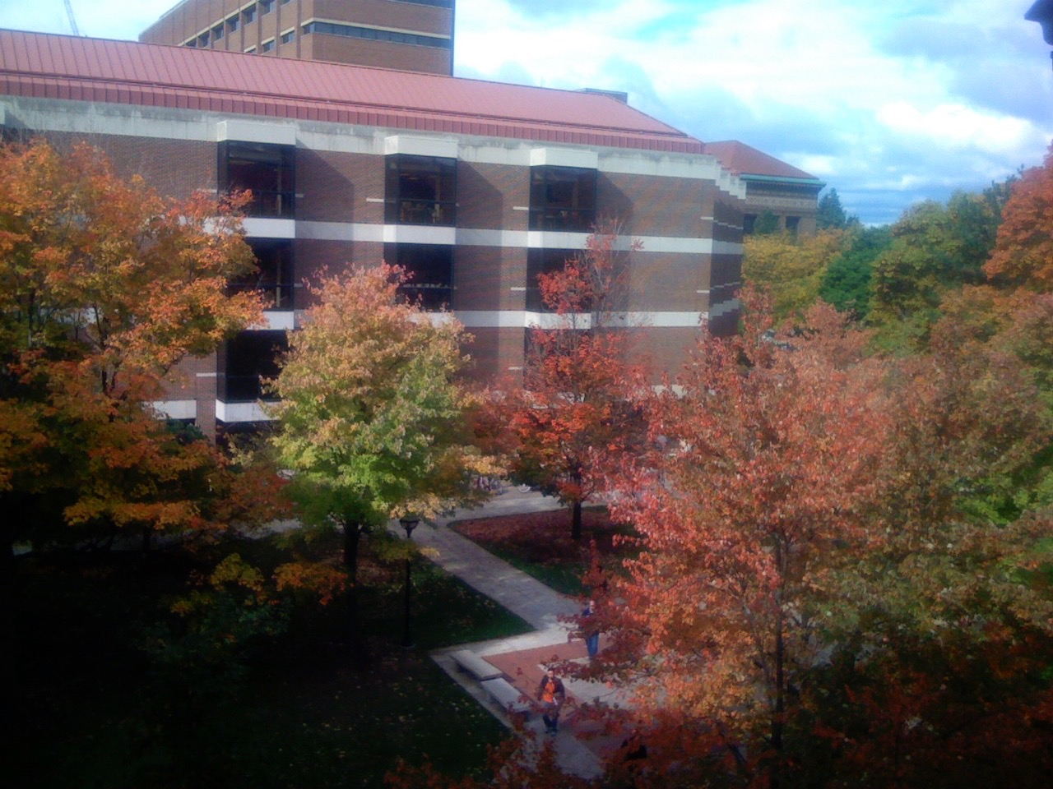
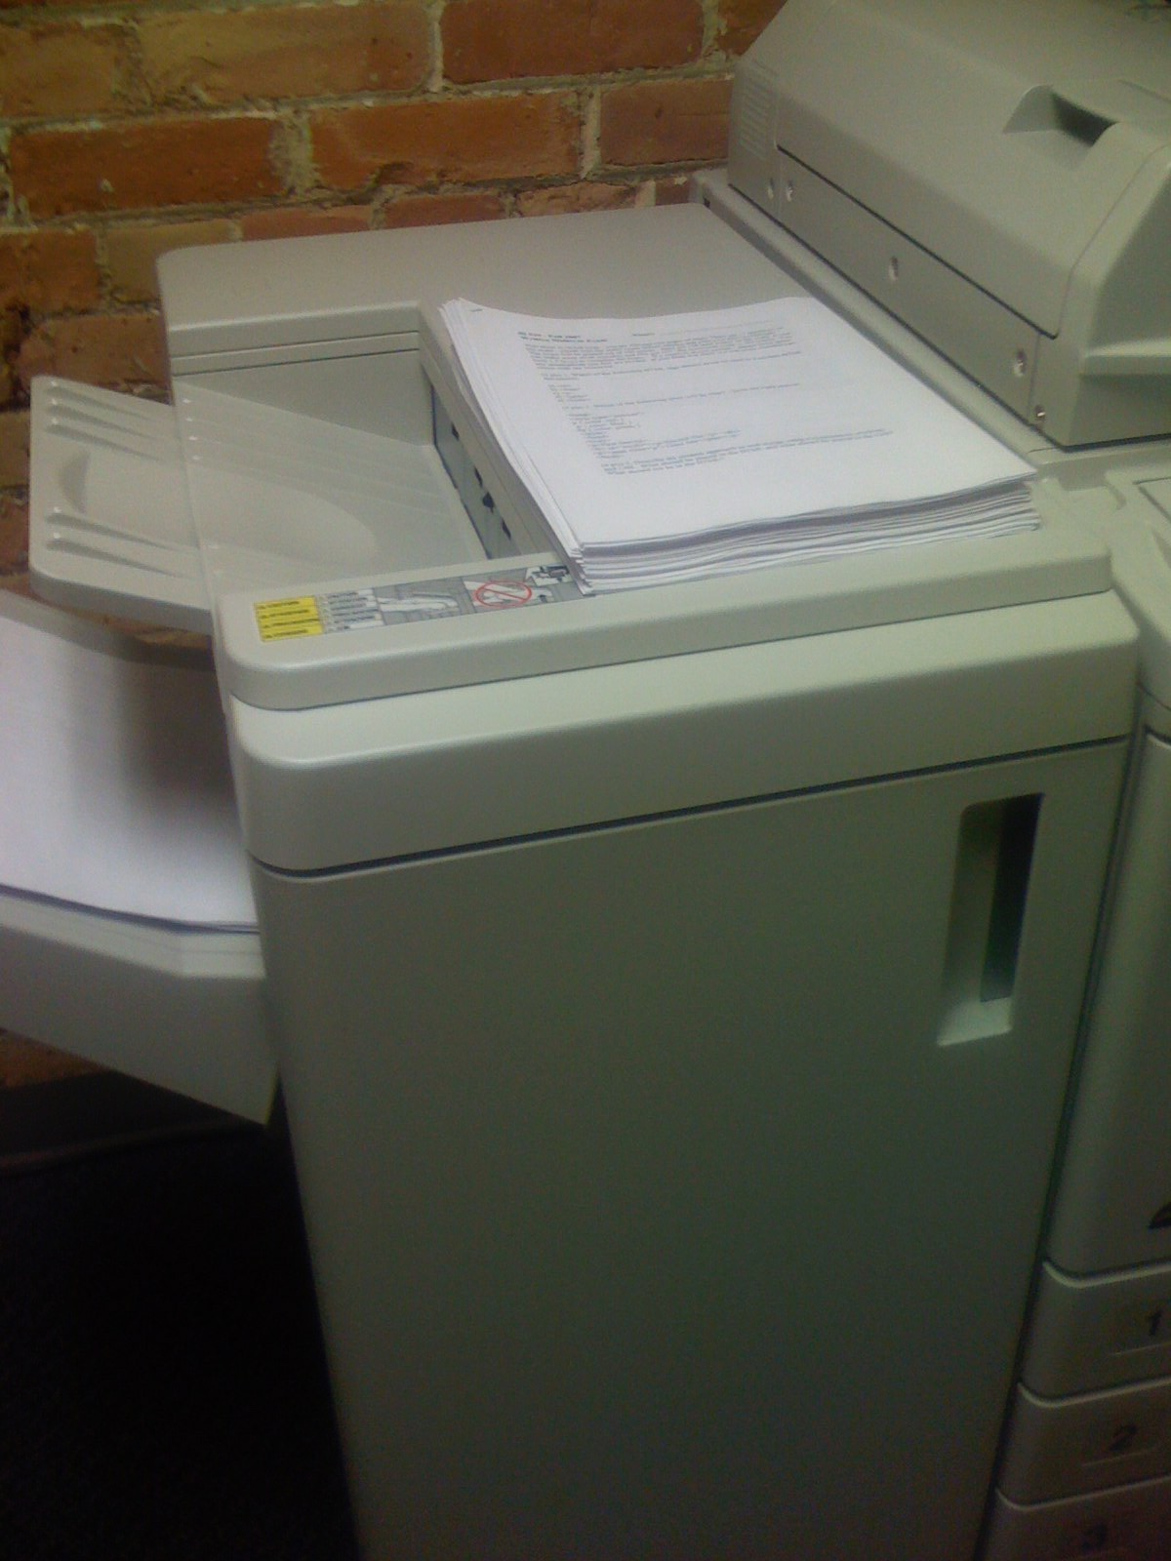

Teach
Relax
Reflect
Recharge
2007

Slide 32


2007

Slide 33

2008

Slide 34

Tools
Interoperability
Commercial
Common
Cartridge
Publishers
LMS
Open Source
Standards
2008
www.imsglobal.org

Slide 35


Slide 36



Slide 37


Slide 38

































2012

Slide 39


Slide 40


Slide 41
Date: March 9, 2012 9:16:54 AM CST
To: feedback+course@coursera.org
Cc: MacKie-Mason, Jeffrey <jmm@umich.edu>
Subject: I would like to Teach a Course on Coursera - Internet History and Technology
Dear Coursera,
I would like to teach a course on Coursera titled "Internet History and Technology". As background, I teach a course titled "SI502 - Networked Computing: Storage, Communication, and Processing"
It is a course on technology for non-technologists. I attach its syllabus ...

Slide 42
Date: March 10, 2012 10:02:52 PM CST
From: MacKie-Mason, Jeffrey <jmm@umich.edu>
Subject: Re: I would like to Teach a Course ...
Chuck,
Martha is in charge of Coursera if you want to approach her directly.
Jeff

Slide 43
Date: March 11, 2012 4:23:20 PM CDT (Sunday)
From: Martha Pollack <pollackm@umich.edu>
Subject: RE: I would like to Teach a Course on Coursera
To: Charles Severance <csev@umich.edu>
Cc: MacKie-Mason, Jeffrey <jmm@umich.edu>
Yes, yes, yes, I’d love to have you do this, as part of the initial group of UM faculty developing Coursera courses! I’m scrambling right now, so will send you more information later (either this evening or tomorrow), and then we can talk.
--Martha

Slide 44


Slide 45
Internet: TCI
Nuthin’ But Net

Slide 47

2012

Slide 48
N=4701
http://www.dr-chuck.com/coursera/insidetheinternet/2012-001/maps/where.html

Slide 49
Megan (UK)
Karen (NC)
Mazen (Egypt)
Sue (CA)
Susan (PA)
Mauro (Italy)

Slide 50
New York, Los Angeles, Ann Arbor, Chicago, Washington DC, Memphis, Seattle, Seoul, Barcelona, London, Mexico City, Amsterdam, Manila Melbourne, Perth...
http://office-hours.dr-chuck.com
Notes:
Since I have a very active travel schedule, I decided to hold office hours in the major cities I have visited. I have held office hours in over 40cities and in each location somewhere between two and 15 students show up.

Slide 51

https://youtu.be/4hIwl_8hmq8

Slide 52

2015

Slide 53


Slide 54





Open Educational Resources

Slide 55


Slide 56


Slide 57


Slide 58
Beyond the LMS

Slide 59

https://net.educause.edu/ir/library/pdf/eli3035.pdf

Slide 60

The Conclusion: The NGDLE is More Than an LMS
“An early conclusion from our research is that although the NGDLE might include a traditional LMS as a component, it will not itself be a single application like the current LMS or other enterprise applications. Rather, the NGDLE will be an ecosystem of sorts . . . “
https://net.educause.edu/ir/library/pdf/eli3035.pdf

Slide 61


Slide 62

interoperability
Source: Malcolm Brown

Slide 63

Historic
Levels of
Venture
Investment
in EdTech
Source: GSV: American
Revolution 2.0
http://gsvadvisors.com

Slide 64

http://coursera.tumblr.com/post/103477375027/learn-from-coursera-on-your-next-jetblue-flight

Slide 65

https://press.linkedin.com/site-resources/news-releases/2015/linkedin-to-acquire-lyndacom

Slide 66


Slide 67


Slide 68







March 6, 2008 iPhone SDK Press Conference

Slide 69

www.tsugi.org

Slide 70


Slide 71


Slide 72


Slide 73

http://hibbittsdesign.org/blog/tags:Flipped-LMS
Notes:
Paul Hibbetts – University of British Columbia

Slide 74

www.elmsn.org

Slide 75




In building the NGDLE, open source will be first to market..

